Slide 1
HDDS1104 Operating Systems and Networking
Topic 3 - Memory Management

Slide 2
Intended Learning Outcomes
Describe basic memory management concepts
Explain Dynamic storage allocation
Describe the mechanism of Virtual memory

Slide 3
Memory management concepts
Topic 3.1
Silberschatz (2013) Chapter 8

Slide 4
Background
Program must be brought (from disk) into memory and placed within a process for it to be run
Main memory and registers are only storage CPU can access directly
Memory unit only sees a stream of
addresses + read requests, or
address + data and write requests
Register access in one CPU clock (or less)
Main memory can take many cycles, causing a stall
Cache sits between main memory and CPU registers
Protection of memory required to ensure correct operation

Slide 5
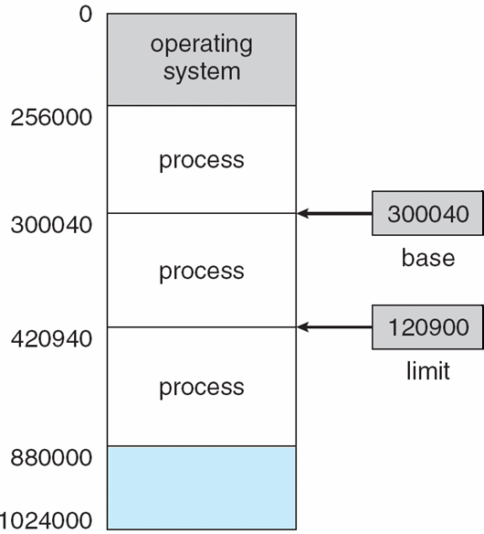
Base and Limit Registers
A pair of base and limit registers define the logical address space
CPU must check every memory access generated in user mode to be sure it is between base and limit for that user

Slide 6
Hardware Address Protection

Slide 7
Address Binding
Programs on disk, ready to be brought into memory to execute form an input queue
Without support, must be loaded into address 0000
Inconvenient to have first user process physical address always at 0000
How can it not be?
Further, addresses represented in different ways at different stages of a program’s life
Source code addresses usually symbolic
Compiled code addresses bind to relocatable addresses
i.e. “14 bytes from beginning of this module”
Linker or loader will bind relocatable addresses to absolute addresses
i.e. 74014
Each binding maps one address space to another

Slide 8
Binding of Instructions and Data to Memory
Address binding of instructions and data to memory addresses can happen at three different stages
Compile time: If memory location known a priori, absolute code can be generated; must recompile code if starting location changes
Load time: Must generate relocatable code if memory location is not known at compile time
Execution time: Binding delayed until run time if the process can be moved during its execution from one memory segment to another
Need hardware support for address maps (e.g., base and limit registers)

Slide 9

Multistep Processing of a User Program

Slide 10
Logical vs. Physical Address Space
The concept of a logical address space that is bound to a separate physical address space is central to proper memory management
Logical address – generated by the CPU; also referred to as virtual address
Physical address – address seen by the memory unit
Logical and physical addresses are the same in compile-time and load-time address-binding schemes; logical (virtual) and physical addresses differ in execution-time address-binding scheme
Logical address space is the set of all logical addresses generated by a program
Physical address space is the set of all physical addresses generated by a program

Slide 11
Memory-Management Unit (MMU)
Hardware device that at run time maps virtual to physical address
To start, consider simple scheme where the value in the relocation register is added to every address generated by a user process at the time it is sent to memory
The user program deals with logical addresses; it never sees the real physical addresses
Execution-time binding occurs when reference is made to location in memory
Logical address bound to physical addresses

Slide 12
Dynamic storage allocation
Topic 3.2 Silberschatz (2013) Ch 8

Slide 13
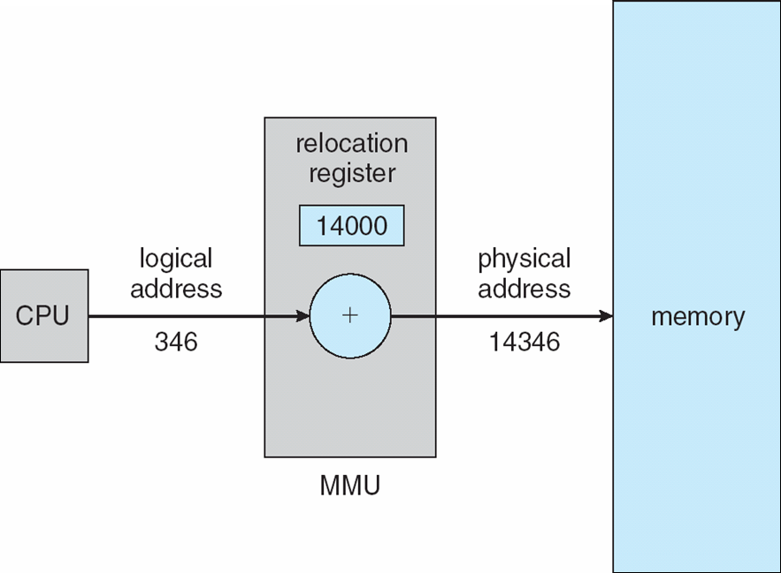
Dynamic relocation using a relocation register
Routine is not loaded until it is called
Better memory-space utilization; unused routine is never loaded
All routines kept on disk in relocatable load format
Useful when large amounts of code are needed to handle infrequently occurring cases
No special support from the operating system is required
Implemented through program design
OS can help by providing libraries to implement dynamic loading

Slide 14
Dynamic Linking
Static linking – system libraries and program code combined by the loader into the binary program image
Dynamic linking –linking postponed until execution time
Dynamic linking is particularly useful for libraries
System also known as shared libraries
Consider applicability to patching system libraries
Versioning may be needed

Slide 15
Swapping
A process can be swapped temporarily out of memory to a backing store, and then brought back into memory for continued execution
Total physical memory space of processes can exceed physical memory
Backing store – fast disk large enough to accommodate copies of all memory images for all users; must provide direct access to these memory images
Roll out, roll in – swapping variant used for priority-based scheduling algorithms; lower-priority process is swapped out so higher-priority process can be loaded and executed
Major part of swap time is transfer time; total transfer time is directly proportional to the amount of memory swapped
System maintains a ready queue of ready-to-run processes which have memory images on disk

Slide 16
Swapping (Cont.)
Does the swapped out process need to swap back in to same physical addresses?
Depends on address binding method
Plus consider pending I/O to / from process memory space
Modified versions of swapping are found on many systems (i.e., UNIX, Linux, and Windows)
Swapping normally disabled
Started if more than threshold amount of memory allocated
Disabled again once memory demand reduced below threshold

Slide 17

Schematic View of Swapping

Slide 18
Multiple-partition allocation
Degree of multiprogramming limited by number of partitions
Variable-partition sizes for efficiency (sized to a given process’ needs)
Hole – block of available memory; holes of various size are scattered throughout memory
When a process arrives, it is allocated memory from a hole large enough to accommodate it
Process exiting frees its partition, adjacent free partitions combined
Operating system maintains information about: a) allocated partitions b) free partitions (hole)

Slide 19
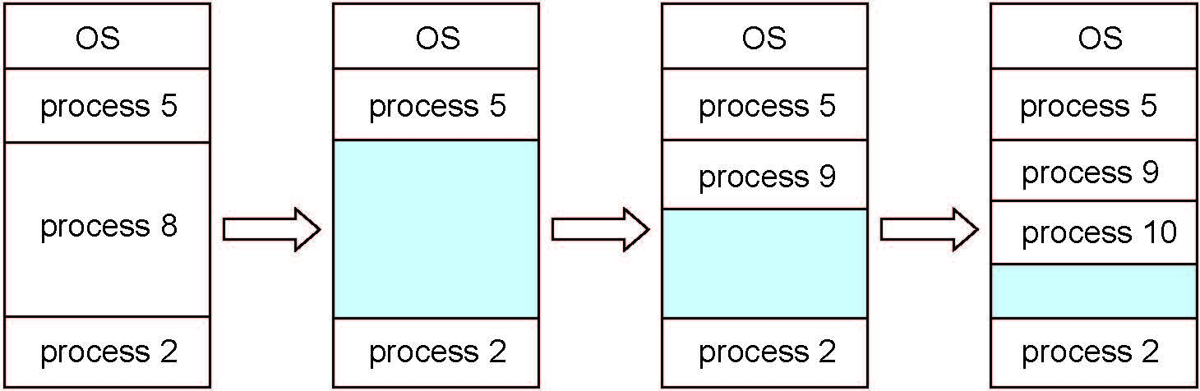
Multiple-partition allocation

Slide 20
Dynamic Storage-Allocation Problem
How to satisfy a request of size n from a list of free holes?
First-fit: Allocate the first hole that is big enough
Best-fit: Allocate the smallest hole that is big enough; must search entire list, unless ordered by size
Produces the smallest leftover hole
Worst-fit: Allocate the largest hole; must also search entire list
Produces the largest leftover hole
First-fit and best-fit better than worst-fit in terms of speed and storage utilization

Slide 21
Fragmentation
External Fragmentation
total memory space exists to satisfy a request, but it is not contiguous
Internal Fragmentation
allocated memory may be slightly larger than requested memory; this size difference is memory internal to a partition, but not being used

Slide 22
Fragmentation (Cont.)
Reduce external fragmentation by compaction
Shuffle memory contents to place all free memory together in one large block
Compaction is possible only if relocation is dynamic, and is done at execution time
I/O problem
Latch job in memory while it is involved in I/O
Do I/O only into OS buffers
Now consider that backing store has same fragmentation problems

Slide 23
Segmentation
Memory-management scheme that supports user view of memory
program is a collection of segments
segment is a logical unit
Segments
main program
local variables, global variables
common block
stack
symbol table
subroutine

Slide 24
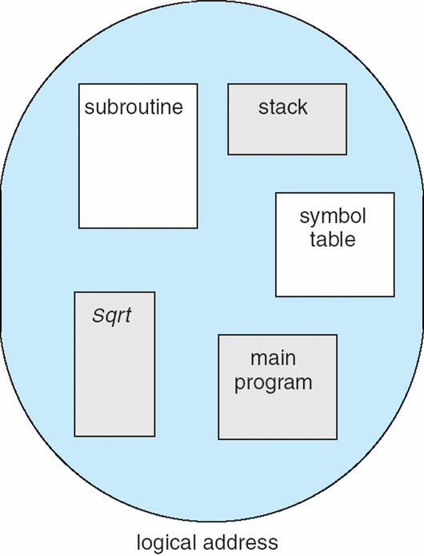
User’s View of a Program

Slide 25
Logical View of Segmentation
1
1
4
2
3
4
2
3
user space
physical memory space

Slide 26
Paging
Physical address space of a process can be noncontiguous; process is allocated physical memory whenever the latter is available
Avoids external fragmentation
Avoids problem of varying sized memory chunks
Divide physical memory into fixed-sized blocks called frames
Size is power of 2, between 512 bytes and 16 Mbytes
Divide logical memory into blocks of same size called pages
Keep track of all free frames
To run a program of size N pages, need to find N free frames and load program
Set up a page table to translate logical to physical addresses
Backing store likewise split into pages
Still have Internal fragmentation

Slide 27
Address Translation Scheme
Address generated by CPU is divided into:
Page number (p) – used as an index into a page table which contains base address of each page in physical memory
Page offset (d) – combined with base address to define the physical memory address that is sent to the memory unit
If the size of the logical address space is 2^{m}, and a page size is 2^{n} bytes, then the high-order m− n bits of a logical address designate the page number, and the n low-order bits designate the page offset. Thus, the logical address is as follows:
For given logical address space 2^{m} and page size 2^{n}
Given: n=2 and m=4, the logical address space is therefore equal to 16 and the page size is 4.

Slide 28

Paging Model of Logical and Physical Memory

Slide 29

Paging Example
Using a page size of 4 bytes and a physical memory of 32 bytes (8 pages), we show how the programmer’s view of memory can be mapped into physical memory.
n=2 and m=4 32-byte memory and 4-byte pages

Slide 30

Free Frames
Before allocation
After allocation

Slide 31
Memory Protection
Memory protection implemented by associating protection bit with each frame to indicate if read-only or read-write access is allowed
Can also add more bits to indicate page execute-only, and so on
Valid-invalid bit attached to each entry in the page table:
“valid” indicates that the associated page is in the process’ logical address space, and is thus a legal page
“invalid” indicates that the page is not in the process’ logical address space
Any violations result in a trap to the kernel

Slide 32

Valid (v) or Invalid (i) Bit In A Page Table

Slide 33
Virtual memory
Topic 3.3
Silberschatz (2013) Ch 9

Slide 34
Background
Code needs to be in memory to execute, but entire program rarely used
Error code, unusual routines, large data structures
Entire program code not needed at same time
Consider ability to execute partially-loaded program
Program no longer constrained by limits of physical memory
Each program takes less memory while running -> more programs run at the same time
Increased CPU utilization and throughput with no increase in response time or turnaround time
Less I/O needed to load or swap programs into memory -> each user program runs faster

Slide 35
Background (Cont.)
Virtual memory – separation of user logical memory from physical memory
Only part of the program needs to be in memory for execution
Logical address space can therefore be much larger than physical address space
Allows address spaces to be shared by several processes
Allows for more efficient process creation
More programs running concurrently
Less I/O needed to load or swap processes

Slide 36
Background (Cont.)
Virtual address space – logical view of how process is stored in memory
Usually start at address 0, contiguous addresses until end of space
Meanwhile, physical memory organized in page frames
MMU must map logical to physical
Virtual memory can be implemented via:
Demand paging
Demand segmentation

Slide 37
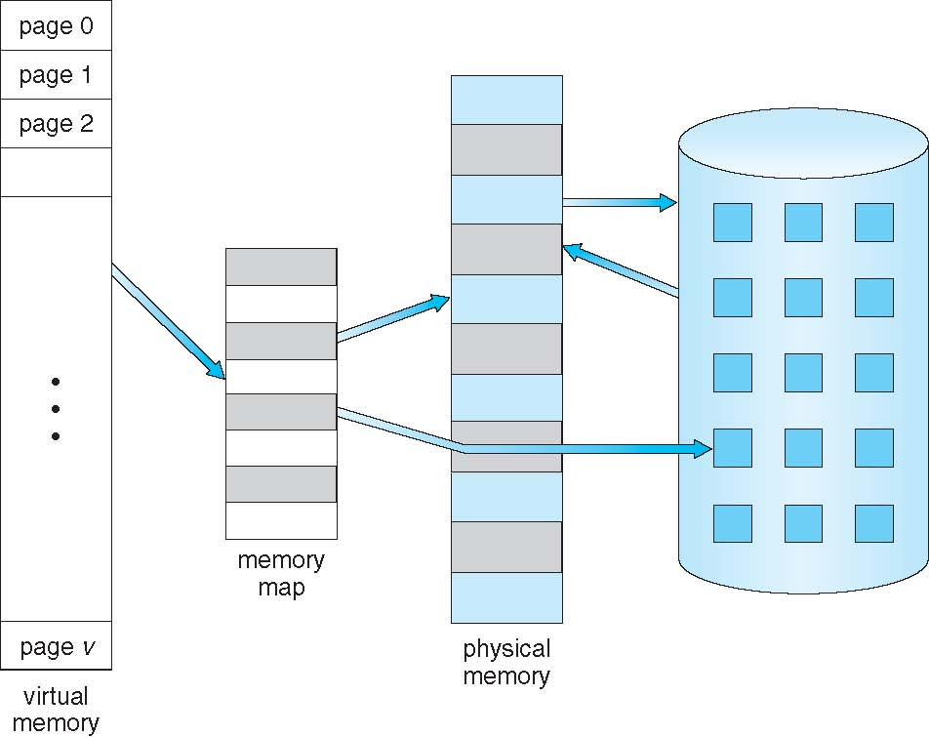
Virtual Memory That is Larger Than Physical Memory

Slide 38

Demand Paging
Could bring entire process into memory at load time
Or bring a page into memory only when it is needed
Less I/O needed, no unnecessary I/O
Less memory needed
Faster response
More users
Similar to paging system with swapping (diagram on right)
Page is needed ⇒ reference to it
invalid reference ⇒ abort
not-in-memory ⇒ bring to memory
Lazy swapper – never swaps a page into memory unless page will be needed
Swapper that deals with pages is a pager

Slide 39
Basic Concepts
With swapping, pager guesses which pages will be used before swapping out again
Instead, pager brings in only those pages into memory
How to determine that set of pages?
Need new MMU functionality to implement demand paging
If pages needed are already memory resident
No difference from non demand-paging
If page needed and not memory resident
Need to detect and load the page into memory from storage
Without changing program behavior
Without programmer needing to change code

Slide 40
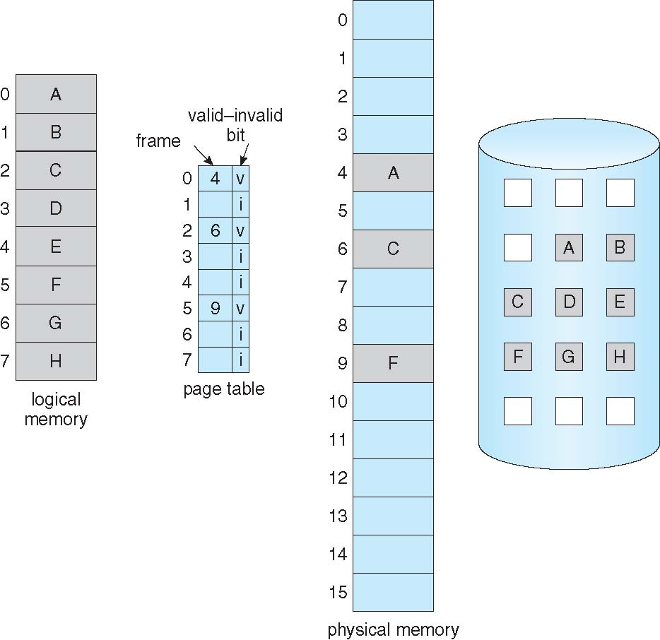
Page Table When Some Pages Are Not in Main Memory

Slide 41
Page Fault
If there is a reference to a page, first reference to that page will trap to operating system:
page fault
Operating system looks at another table to decide:
Invalid reference ⇒ abort
Just not in memory
Find free frame
Swap page into frame via scheduled disk operation
Reset tables to indicate page now in memory Set validation bit = v
Restart the instruction that caused the page fault

Slide 42

Steps in Handling a Page Fault

Slide 43
Page Replacement
Prevent over-allocation of memory by modifying page-fault service routine to include page replacement
Use modify (dirty) bit to reduce overhead of page transfers – only modified pages are written to disk
Page replacement completes separation between logical memory and physical memory – large virtual memory can be provided on a smaller physical memory

Slide 44
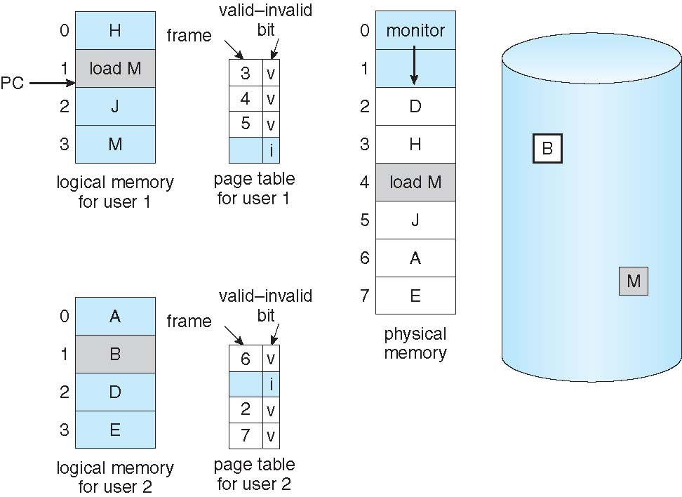
Need For Page Replacement

Slide 45
Basic Page Replacement
Find the location of the desired page on disk
Find a free frame: - If there is a free frame, use it - If there is no free frame, use a page replacement algorithm to select a victim frame - Write victim frame to disk if dirty
Bring the desired page into the (newly) free frame; update the page and frame tables
Continue the process by restarting the instruction that caused the trap
Note now potentially 2 page transfers for page fault – increasing EAT

Slide 46
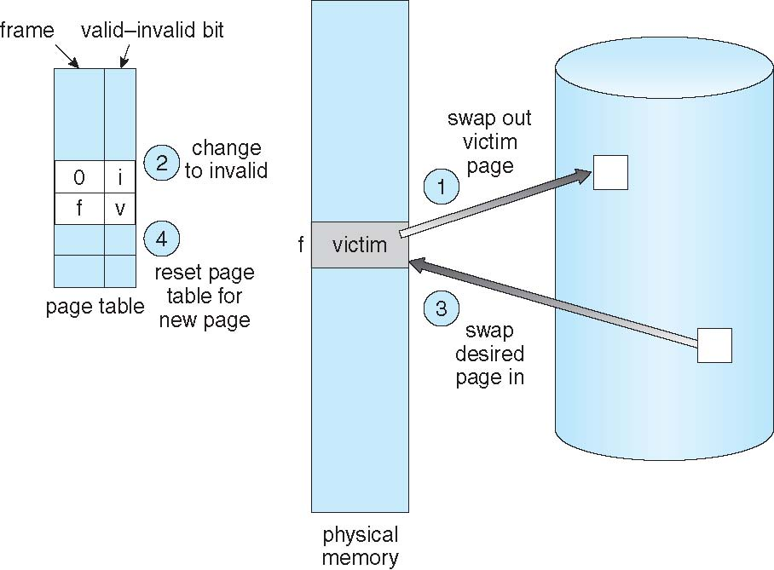
Page Replacement

Slide 47
Thrashing
If a process does not have “enough” pages, the page-fault rate is very high
Page fault to get page
Replace existing frame
But quickly need replaced frame back
This leads to:
Low CPU utilization
Operating system thinking that it needs to increase the degree of multiprogramming
Another process added to the system
Thrashing ≡ a process is busy swapping pages in and out

Slide 48
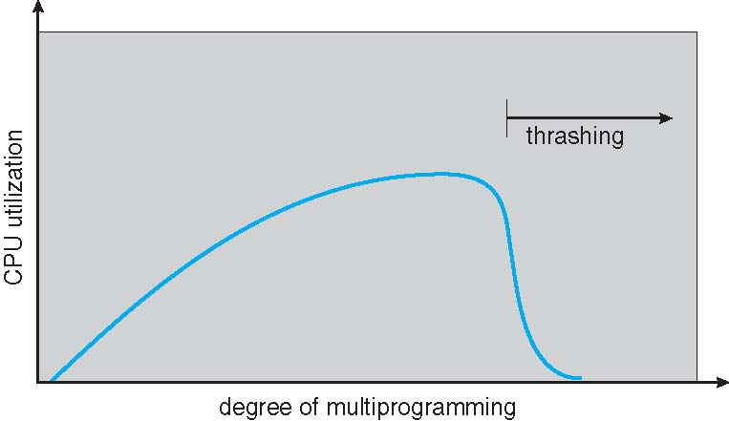
Thrashing (Cont.)

